Slide 1
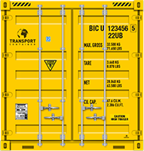
Professional Tracking System For Containers
SL411 is a universal compact intelligent terminal for containers. The main equipment can be flexibly installed nearby the Container Vent. Professional IoT battery, low battery consumption, waterproof level IP67, GPS + WiFi + LBS triple positioning chipset, global roaming SIM card pre-installed, wire/wireless door sensor…
Product features
Without Manual maintenance |  | Long-term working period
Support OTA Remote Upgrade and Configuration |  | High-performance, high-capacity IoT special battery
Precise positioning |  | Easy installation
Use GPS satellite, LBS base station, WiFi multiple positioning methods |  | Installed by glue or hanging holes, flexible installed to multiple locations in the container
Rapid deployment, secure integration |  | Global roaming
Support HTTPS/TCP/UDP protocol interface |  | Support 4G/3G/2G roaming in more than 170 countries around the world
Wired/wireless sensor |  | Three-proof design
Put the wireless sensor inside the box to monitor the status of the box in real time. Easy to install, without wire and hole. |  | Within -40 ° C ~ 85 ° C , can work well all the year in the world. Support IP67, pass the rigorous three-proof test
Installation appearance

Slide 2
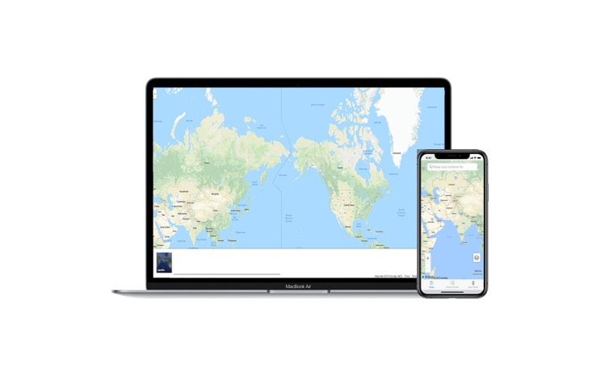
Intelligent container management platform
 |  | Dashboard
 |  | Users can view the current location of all smart containers in the world. Users can get a clear understanding of the global distribution of containers through this interface, and can get the details of each smart container by clicking each node
 |  |  | Motion track
 |  |  | Users can view the historical movement trajectory of each container through this Location track function, and know the duration of every smart container staying at each position, etc., so the customer can analyze and adjust route based on this trajectory.
 |  | Device Details
 |  | Users can view the current status of the smart container by this function, such as location, temperature, power, signal, etc. Through this interface, the customer can grasp the container information and status in real time.
 |  | Device Configure
 |  | The user can manage the smart container remotely t through this function. Through this interface, the positioning cycle, warning setting, work scene, etc. of the management device can be configured, and the customer can remotely complete the smart container management without going to the site.

Slide 3
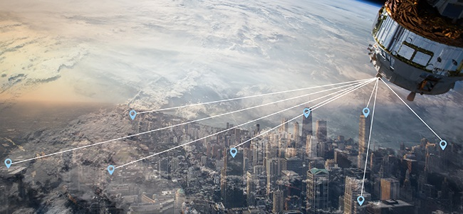
Technical specifications
Items | Specitions | Remarks
Appearance | Host Size | 205*67*26mm
 | Antenna size | 60*40*20mm
 | Weight | 350g
Positioning | Location Mode | GPS+A-GPS+WiFi+LBS
 | Positioning accuracy requirements | <15meters（Open Sky）
 | Positioning time | Cold start＜60s（Open Sky）
Network | FDD-LTE:B1/B2/B3/B4/B5/B7/B8/B12/B13/B18/ B19/B20/B25/B26/B28 TDD-LTE:B38/B39/B40/B41 UMTS:B1/B2/B4/B5/B6/B8/B19 GSM:B2/B3/B5/B8 | Type：SL411-OA-G（Global version）
 | FDD-LTE:B1/B3/B5/B8 TDD-LTE:B38/B39/B40/B41 UMTS:B1/B8 GSM:900/1800 | Type：SL411-OA-C（Asia Pacific version）
 | SIM cards | SMTSIM、Nano SIM、SoftSIM
Battery | Standby current | <20uA
 | Working current | <400mA
 | Battery Voltage | 3.6V
 | Battery Capacity | 12000mAh
 | Number of Data reporting | 5000pcs
Build-in Sensor | Battery voltage detection | 0~4V
 | Temperature detection | ﹣40℃～＋85℃
 | Motion detection | Triaxial<=16g
Environment | Operating temperature | ﹣40℃～＋85℃
 | Working humidity | 5% ～ 95%
 | Waterproof rating | IP67
Professional GPS Tracking System for Containers
Vjoy Car Electronics Limited
No.405,Ze Hua Building,No.988 Mei Long Road
Long Hua District
Shenzhen,518108 China.
Tel:+86-755-36317464 Fax:+86-755-66620978
Mob:+86 136 2192 5935 Email:sales@vjoycar.com
Websit: www.vjoycar.com
Smart Container | Container Positioning| Container Monitoring | Container Tracker | Container GPS

